Slide 1
Grammatical inference: an introduction
Module X3IT040, Colin de la Higuera

Slide 2
Outline
1
What is grammatical inference about?
2
Why is it a difficult task?
3
Why is it a useful task?
4
Validation issues
5
Some criteria

Slide 3
What is grammatical inference about?

Slide 4
1. Grammatical inference
is about learning a grammar given information about a language
Information is strings, trees or graphs
Information can be (typically)
Text: only positive information
Informant: labelled data
Actively sought (query learning, teaching)

Slide 5
1.1 The functions/goals
Languages and grammars from the Chomsky hierarchy
Probabilistic automata and context-free grammars
Hidden Markov Models
Patterns
Transducers

Slide 6
1.2 The Chomsky hierarchy
Recursively enumerable languages
Context sensitive languages
Regular languages
Context-free languages

Slide 7
1.3 The Chomsky hierarchy revisited
Regular languages
Recognized by DFA, NFA
Generated by regular grammars
Described by regular expressions
Context-free languages
Generated by CF grammars
Recognized by stack automata
Context-sensitive languages
CS grammars
(parsing is not in P)
RE languages (all Turing machines)
Parsing is undecidable

Slide 8
1.4 Other formalisms
Topological formalisms
Semilinear languages
Hyperplanes
Balls of strings

Slide 9
1.5 Distributions of strings
A probabilistic automaton defines a distribution over the strings

Slide 10
1.6 Fuzzy automata
An automaton will say that string w belongs to the language with probability P
The difference with the probabilistic automata is that
The total sum of probabilities may be different than 1 (may even be infinite)
The fuzzy automaton cannot be used as a generator of strings

Slide 11
1.7 Multiplicity automata
a: 2
a: 1
6
3
1
2
b : 5
b: 3
a: 5
b: 4
When the numbers sum up the right way they can be called frequency automata

Slide 12
1.8 Weighted automata
0.1
b
a
0.9
a
0.35
0.7
a
0.7
b
b
0.65
0.3
0.3
In this case some properties are met allowing the automaton to define a distribution, so the automaton is probabilistic

Slide 13
1.9 The data: examples of strings
A string in Gaelic and its translation to English:
Tha thu cho duaichnidh ri èarr àirde de a’ coisich deas damh
You are as ugly as the north end of a southward traveling ox

Slide 14
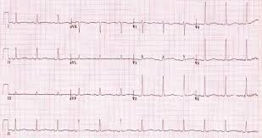
The data: examples of strings
Time series pose the problem of the alphabet:
An infinite alphabet?
Discretizing?
An ordered alphabet
Sinus rhythm with acquired long QT, work found via Flickr, by Popfossa, CC BY 2.0

Slide 15
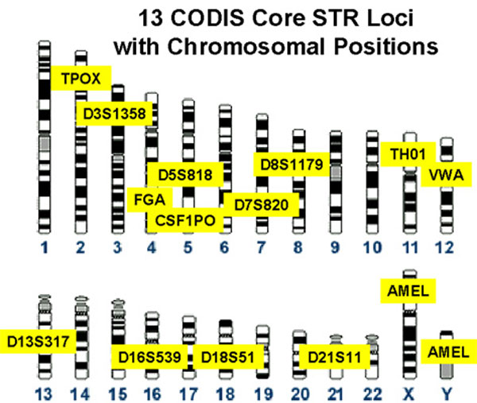
The data: examples of strings
Codis profile, Chemical Science & Technology Laboratory, National Institute of Standards and Technology, work found via Wikipedia, CC BY-SA 3.0

Slide 16
The data: examples of strings
>A BAC=41M14 LIBRARY=CITB_978_SKB
AAGCTTATTCAATAGTTTATTAAACAGCTTCTTAAATAGGATATAAGGCAGTGCCATGTA
GTGGATAAAAGTAATAATCATTATAATATTAAGAACTAATACATACTGAACACTTTCAAT
GGCACTTTACATGCACGGTCCCTTTAATCCTGAAAAAATGCTATTGCCATCTTTATTTCA
GAGACCAGGGTGCTAAGGCTTGAGAGTGAAGCCACTTTCCCCAAGCTCACACAGCAAAGA
CACGGGGACACCAGGACTCCATCTACTGCAGGTTGTCTGACTGGGAACCCCCATGCACCT
GGCAGGTGACAGAAATAGGAGGCATGTGCTGGGTTTGGAAGAGACACCTGGTGGGAGAGG
GCCCTGTGGAGCCAGATGGGGCTGAAAACAAATGTTGAATGCAAGAAAAGTCGAGTTCCA
GGGGCATTACATGCAGCAGGATATGCTTTTTAGAAAAAGTCCAAAAACACTAAACTTCAA
CAATATGTTCTTTTGGCTTGCATTTGTGTATAACCGTAATTAAAAAGCAAGGGGACAACA
CACAGTAGATTCAGGATAGGGGTCCCCTCTAGAAAGAAGGAGAAGGGGCAGGAGACAGGA
TGGGGAGGAGCACATAAGTAGATGTAAATTGCTGCTAATTTTTCTAGTCCTTGGTTTGAA
TGATAGGTTCATCAAGGGTCCATTACAAAAACATGTGTTAAGTTTTTTAAAAATATAATA
AAGGAGCCAGGTGTAGTTTGTCTTGAACCACAGTTATGAAAAAAATTCCAACTTTGTGCA
TCCAAGGACCAGATTTTTTTTAAAATAAAGGATAAAAGGAATAAGAAATGAACAGCCAAG
TATTCACTATCAAATTTGAGGAATAATAGCCTGGCCAACATGGTGAAACTCCATCTCTAC
TAAAAATACAAAAATTAGCCAGGTGTGGTGGCTCATGCCTGTAGTCCCAGCTACTTGCGA
GGCTGAGGCAGGCTGAGAATCTCTTGAACCCAGGAAGTAGAGGTTGCAGTAGGCCAAGAT
GGCGCCACTGCACTCCAGCCTGGGTGACAGAGCAAGACCCTATGTCCAAAAAAAAAAAAA
AAAAAAAGGAAAAGAAAAAGAAAGAAAACAGTGTATATATAGTATATAGCTGAAGCTCCC
TGTGTACCCATCCCCAATTCCATTTCCCTTTTTTGTCCCAGAGAACACCCCATTCCTGAC
TAGTGTTTTATGTTCCTTTGCTTCTCTTTTTAAAAACTTCAATGCACACATATGCATCCA
TGAACAACAGATAGTGGTTTTTGCATGACCTGAAACATTAATGAAATTGTATGATTCTAT

Slide 17
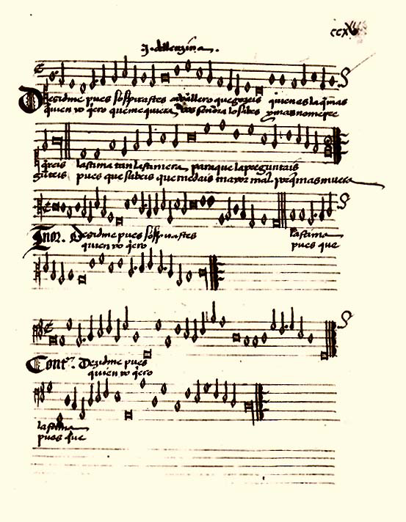
The data: examples of strings
Cancionero de Palacio, work found via Wikipedia, CC BY-SA 3.0

Slide 18
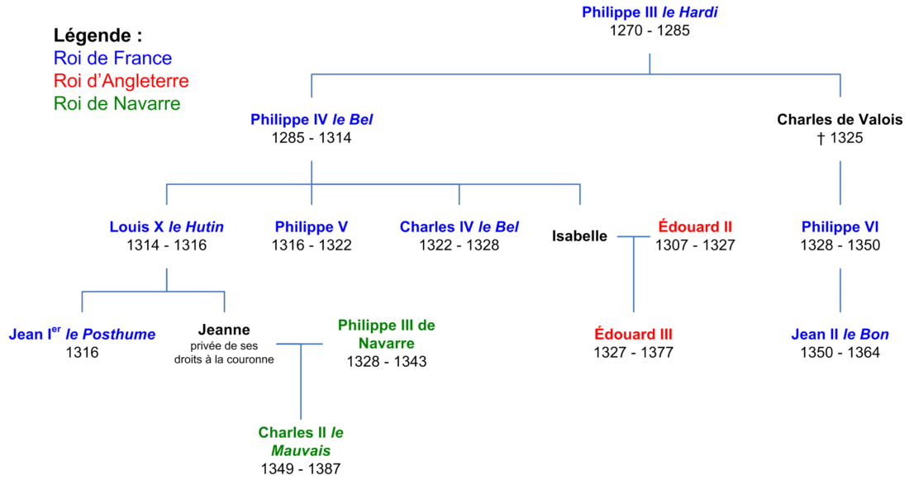
The data: examples of strings
Généalogie2 Guerre de Cent Ans, work found via Wikipedia, CC BY-SA 3.0

Slide 19
The data: examples of strings
Phylogenetic Tree, Woese 1990, Maulucioni, work found via Wikipedia, CC BY-SA 3.0

Slide 20
The data: examples of strings
<book>
<part>
<chapter>
<sect1/>
<sect1>
<orderedlist numeration="arabic">
<listitem/>
<f:fragbody/>
</orderedlist>
</sect1>
</chapter>
</part>
</book>

Slide 21
The data: examples of strings
<?xml version="1.0"?> <?xml-stylesheet href="carmen.xsl" type="text/xsl"?> <?cocoon-process type="xslt"?>
<!DOCTYPE pagina [ <!ELEMENT pagina (titulus?, poema)> <!ELEMENT titulus (#PCDATA)> <!ELEMENT auctor (praenomen, cognomen, nomen)> <!ELEMENT praenomen (#PCDATA)> <!ELEMENT nomen (#PCDATA)> <!ELEMENT cognomen (#PCDATA)> <!ELEMENT poema (versus+)> <!ELEMENT versus (#PCDATA)> ]>
<pagina> <titulus>Catullus II</titulus> <auctor> <praenomen>Gaius</praenomen> <nomen>Valerius</nomen> <cognomen>Catullus</cognomen> </auctor>

Slide 22
The data: examples of strings

Slide 23
And also
Business processes
Bird songs
Images (contours and shapes)
Robot moves
Web services
Malware
…

Slide 24
What does learning mean?

Slide 25
The actors
Classification task
Learning
Induction
Inference
G/A
Yes
0.028
w’
Estimation task
Data data data data data data data
w
Translation task
The learnt grammar/ automaton
Training data
Training sample
Test sample
Test set

Slide 26
What does learning mean?
Suppose we write a program that can build a grammar from some data… are we done?
A first question is: “why bother?”
If my programme works, why do something more about it?
Why should we do something when other researchers in Machine Learning are not?

Slide 27
Motivating reflection #1
print(17); //
x=rand(10000; print(x); //
Is 17 a random number?
Is 0110110110110101011000111101 a random sequence?
Is grammar G the correct grammar for a given sample S?

Slide 28
Motivating reflection #2
In the case of languages, learning is an ongoing process
Is there a moment where we (humans) can say we have learnt a language?

Slide 29
Motivating reflection #3
Statement “I have learnt” does not make sense
Statement “I am learning” makes sense

Slide 30
What usually is called “having learnt”
That the grammar / automaton is the smallest, best (re a score) → Combinatorial characterisation
That some optimisation problem has been solved
That the “learning” algorithm has converged (EM)

Slide 31
What is not said
That having solved some complex combinatorial question we have an Occam, Compression, MDL, Kolmogorov complexity like argument which gives us some guarantee with respect to the future
Computational learning theory has got such results

Slide 32
Simple message
Simplifying the data into a simple grammar (or automaton) means that we have learnt
Careful: this message has been true but recent results with transformer models seem to contradict it:
ChatGPT language model has 175 Billion parameters (175,000,000,000) built from 500 Billion token

